Slide 1
Introduction to Race in America: Reading Race in Literature
ENGL 102-A02
Spring 2019
Instructor: Sydora

Slide 2
What is “Race”?
Race as biology.
Term first coined around 1508.
Definition: scientific classification of phenotypic variations of human beings based on essential, “natural,” and physical differences.
Ex: “One-drop rule” or “black ancestor rule.”

Slide 3
Studying Race in Society
Race as a social construct.
It is not natural and eternal, but social and political.
A category created by humans in the construction of their social reality.
An ideology – a group of intertwining beliefs that makes possible certain kinds of cultural consensus or knowledge seem natural or common sense (Nealon and Giroux 87).

Slide 4
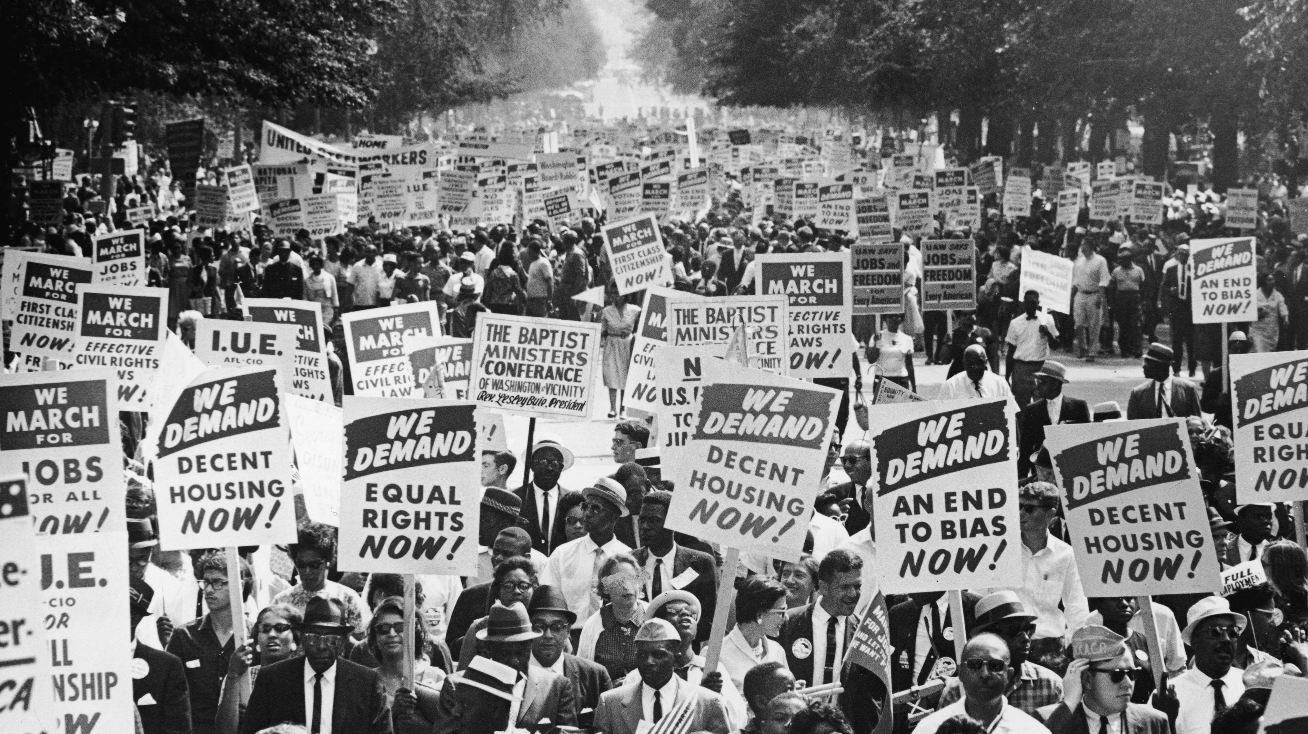
Reading Representations of Race and Racism

Slide 5
“Intersectionality”
Intersectionality is “the interconnected nature of social categorizations such as race, class, and gender as they apply to a given individual or group, regarded as creating overlapping and independent systems of discrimination or disadvantage” (Crenshaw 1989).

Slide 6
Understanding Intersectionality
We are all subject to some forms of privilege and some forms of oppression.
All categories of oppression have a common core: the superiority of one over another; there is no hierarchy of oppression.
When does your privilege uphold some else’s oppression?

Slide 7
Questions for Reading Race and Racism:
Where and in what ways does race appear in dominant American culture and shape the ways we interact?
What types of texts reflect dominant culture’s perceptions of race?
In what ways do texts challenge or subvert racist assumptions?
How do we accurately reflect the experiences of victims of racism?
How does racism continue to function as a pervasive and persistent force in society?
Adapted from: “Critical Race Theory.” OWL Purdue Online Writing Lab. 17 Aug. 2015. Web.

Slide 8
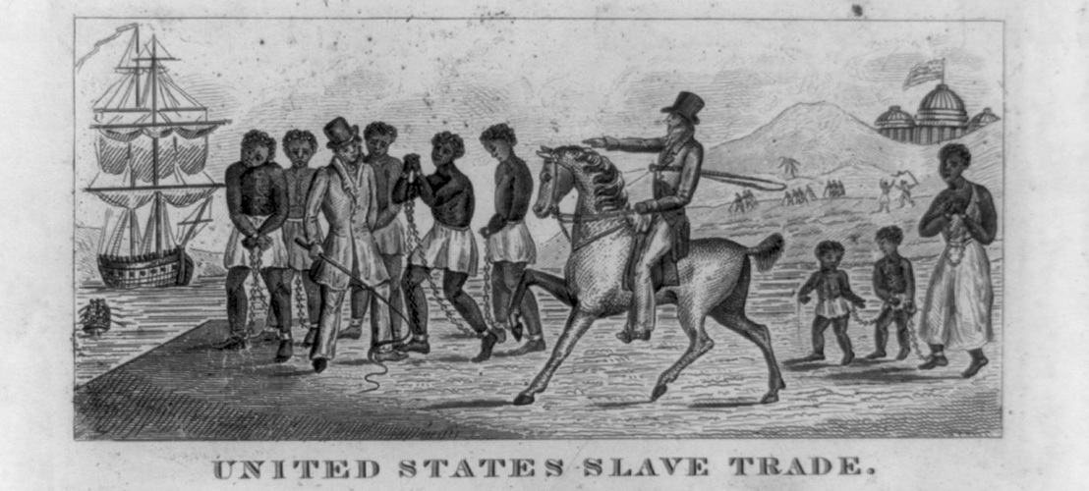
The History of Slavery in America

Slide 9
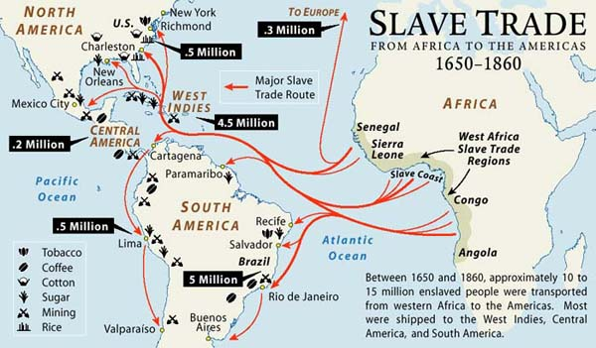
The New World and Slavery
Between 1619 and 1860 some 400,000 slaves transported from Africa to the New World due to labor shortage.

Slide 10
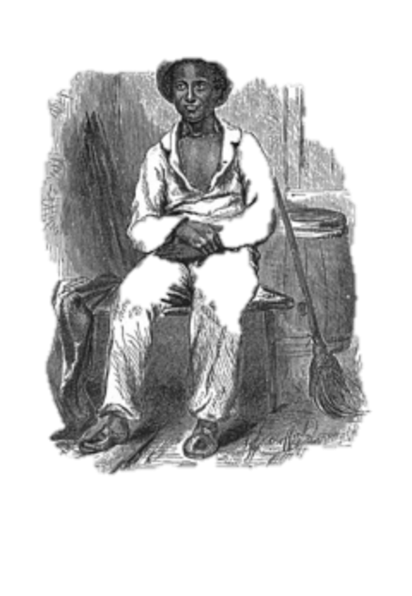
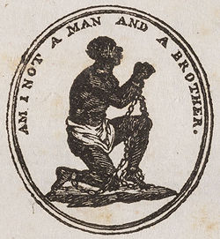
North vs. South
Slave trade officially abolished in 1808 in the U.S.
After the American Revolution slavery proved unprofitable in the North, while the early 19th century cotton revolution in the South depended on the ever-increasing numbers of American-born slaves to sustain its economy.
By 1860, more than 4 million black slaves in the U.S.

Slide 11
The “Peculiar Institution”
The paradox of American slavery leads to a national divide:
Growing movement to abolish slavery in the North (Union) and increasing defense of the institution in the South (Confederacy).
In the South, political, religious, economic and social arguments in favor of the continuation of slavery emerged.
In reality, the “peculiar institution” systematically denied literacy, freedom of movement, and any sense of racial pride or personal autonomy to blacks.

Slide 12
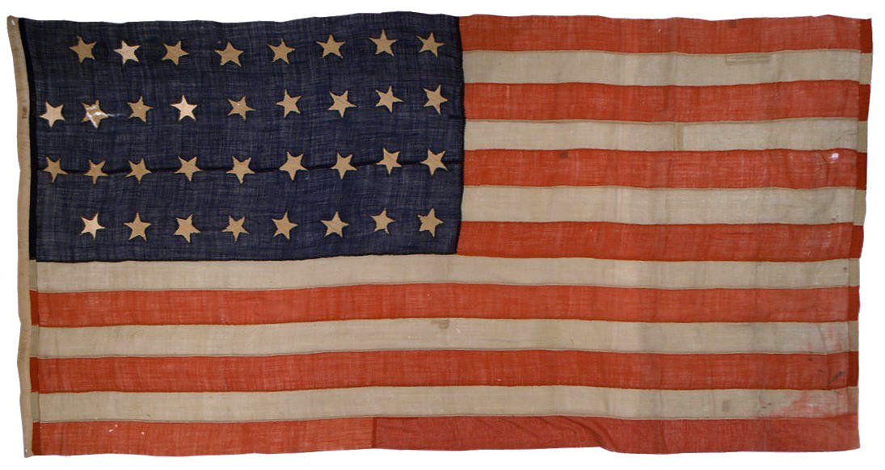

Growing Tension and The Civil War
1857 – Dred Scott Decision: ruled that all African Americans were subhuman property with no rights of citizenship in the United States.
1861-1865: Civil War – began as a struggle to preserve the Union, but many in the North and South felt the conflict of slavery would ultimately decide both issues.
September 22, 1862: President Abraham Lincoln presents Preliminary Emancipation Proclamation

Slide 13
Reconstruction Amendments
13th Amendment (1865)
Outlaws the practice of slavery and involuntary servitude.
14th Amendment (1868)
Former slaves received the rights of citizenship and equal protection of the Constitution.
15th Amendment (1870)
Grants African Americans (men) the right to vote.

Slide 14
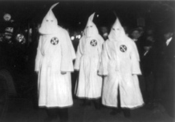
Southern Response to Emancipation
Black Codes: Post-Civil War laws established by Southern states that continued the restrictions of slavery and reduced African-American constitutional rights to a mockery.
White Supremacy Groups:
Ku Klux Klan
Knights of the White Camelia
White Brotherhood
‘76 Association

Slide 15
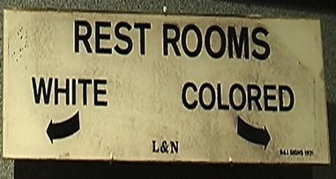
Southern Backlash Continued
Jim Crow Laws (1876): enforced racial segregation in the South between the end of the Reconstruction period (1877) and the beginning of a civil right’s movement in the 1950s.
Plessy vs. Ferguson (1896): advanced the controversial “separate but equal” doctrine.

Slide 16
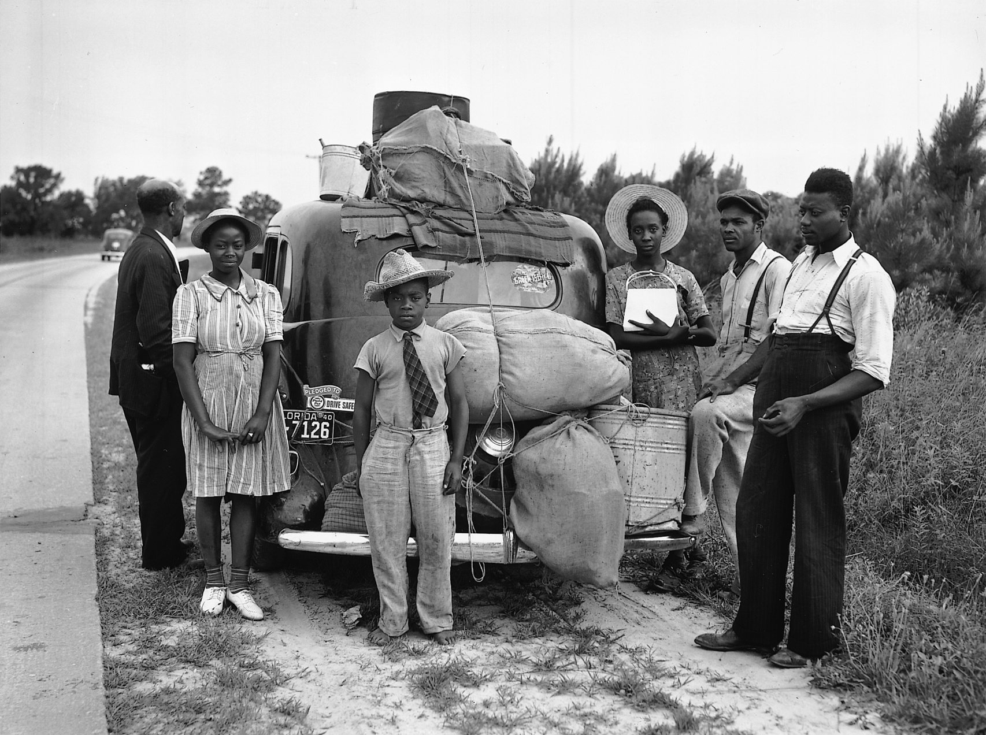
Black American Response at the Turn of the Century
Two important responses to Southern racism:
Emergence of new form of African American writing.
Ex: Paul Laurence Dunbar
The Great Migration
Mass geographical movement
from the 1890s forward by
African Americans, initially
young males, from the
economically depressed rural
South to Northern cities.

Slide 17
Pros and Cons of the Great Migration
Cultural shock resulted in ghetto life:
White neighborhoods adopted restrictive covenants
Poor schooling
Overcrowding
Lack of social amenities
High crime attracted exploiters and racketeers
However, the ghetto also created a black community, homogenized by shared suffering, which quickly established its own institutions and began to recognize its own potential strength (Bigsby and Thompson 161).

Slide 18
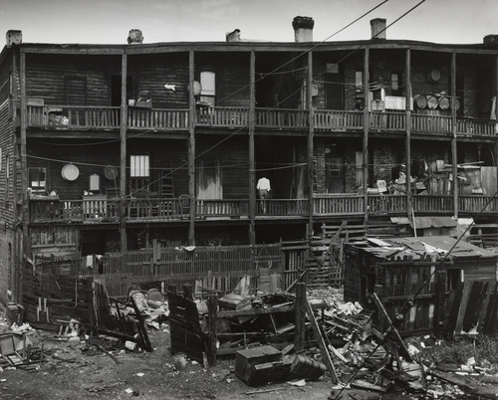

Slide 19
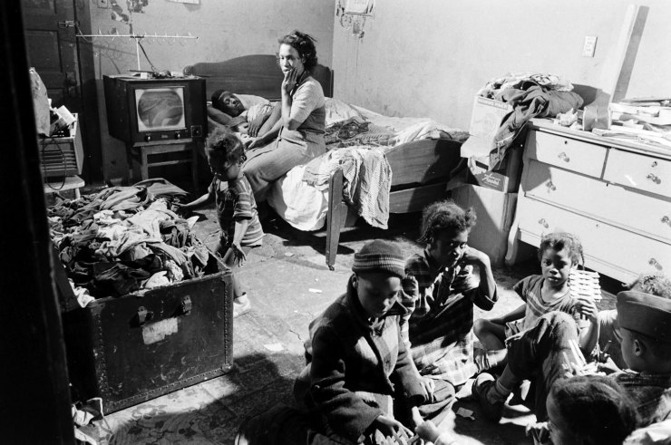

Slide 20
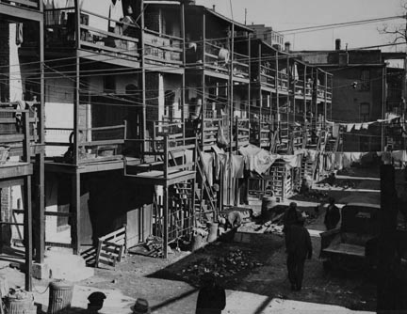

Slide 21
Bibliography
Brizee, Allen et al. “Critical Race Theory.” OWL Purdue Online Writing Lab. 17 Aug. 2015. Web. https://owl.english.purdue.edu/owl/resource/722/14/.
Bigsby, C.W.E. and Roger Thompson. “The Black Experience.” Introduction to American Studies, 3rd ed. Eds. Malcolm Bradbury and Howard Temperley. Longman, 1998. 150-177. Print.
“Slavery in the United States: A Brief History.” Civil War Trust. Web. 10 October, 2014.
Nealon, Jeffrey, and Susan Searls Giroux. The Theory Toolbox: Critical Concepts for the Humanities, Arts, and Social Sciences. New York and Toronto: Rowman & Littlefield Publishers, Inc., 2003. Print.

